Slide 1

Introduction to Git and Github
Raynold Ng
NUS Hackers

Slide 2

Overview
Install git and create a Github account
What is Git
Basic Bash Commands
Using Git
Using Github
Advanced Workflows
Quality of Life Hacks
✅ Gifs
✅ Memes

Slide 3
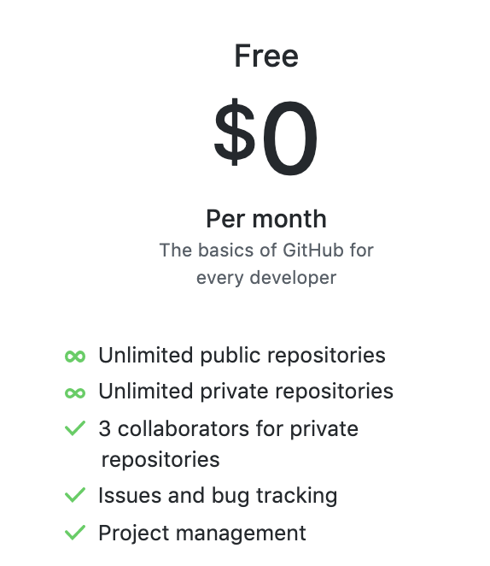
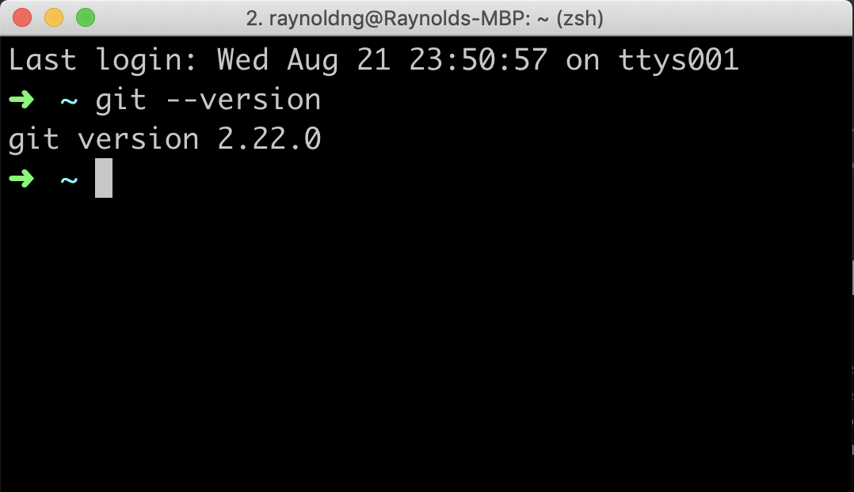
Install Git
Create a Github Account
www.github.com
FREE

Slide 4
Git Config
$ git config --global user.name “<your name>”
$ git config --global user.email “<your email address>”
$ git config --global --add color.ui true
$ git config --list

Slide 5
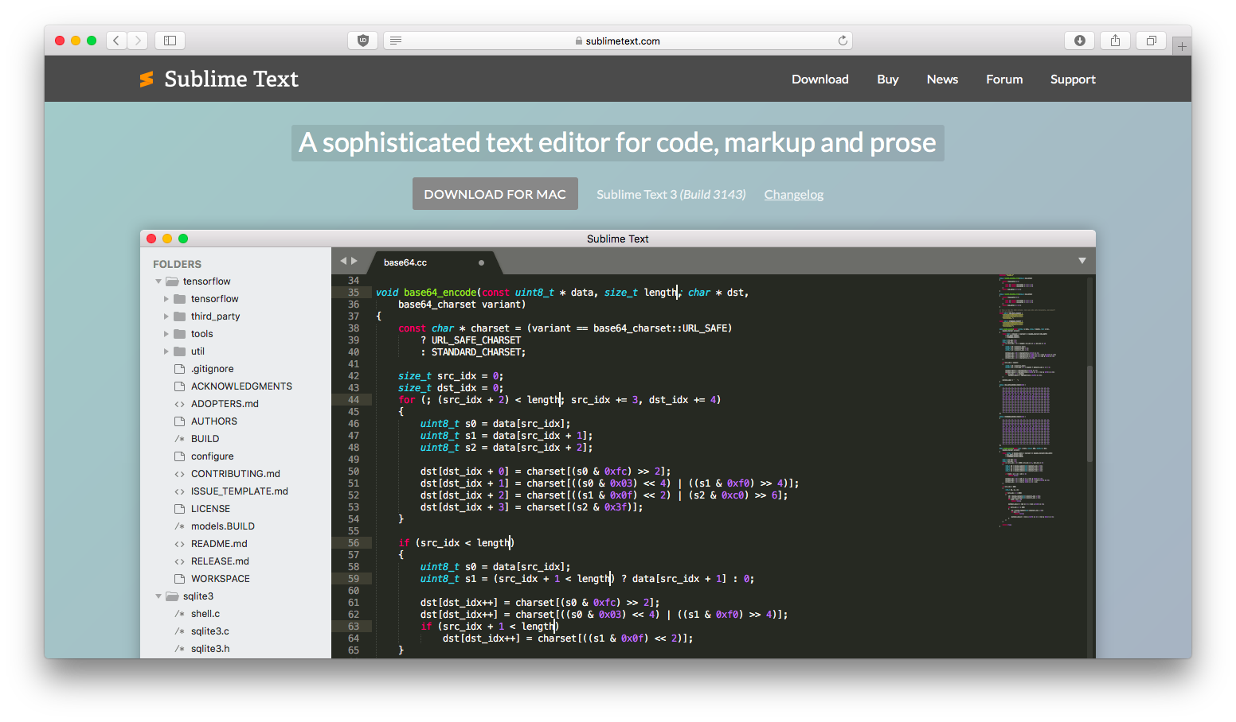
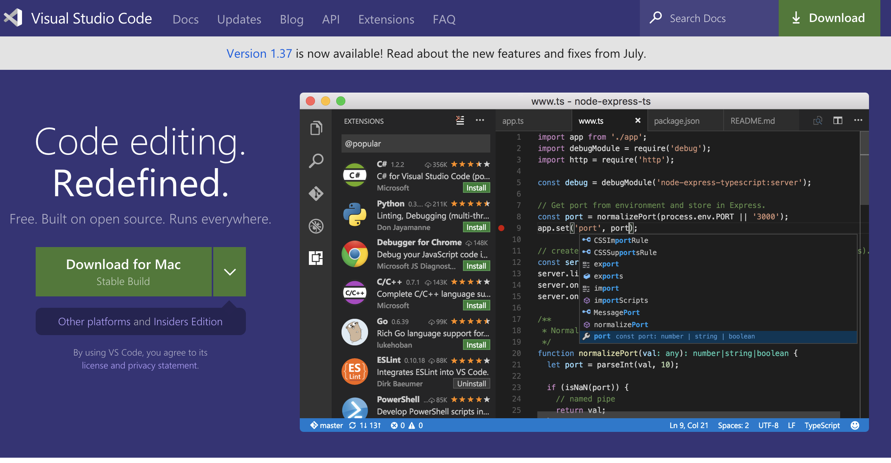
Text Editor

Slide 6
What is Git

Slide 7
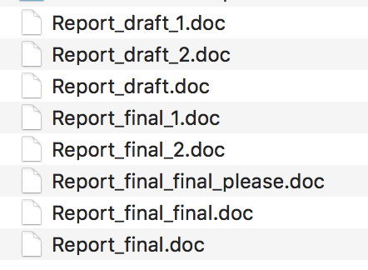
Have you ever seen?

Slide 8
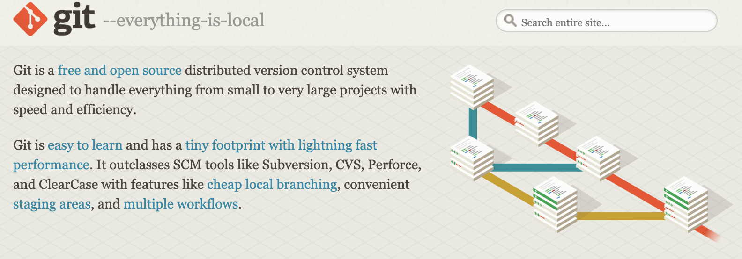



Version Control to the Rescue!
Notes:
Users keep entire code and history on their local machines
users can make any changes without internet access (except for pushing and pulling from a remote server)

Slide 9

Basic Bash Commands

Slide 10
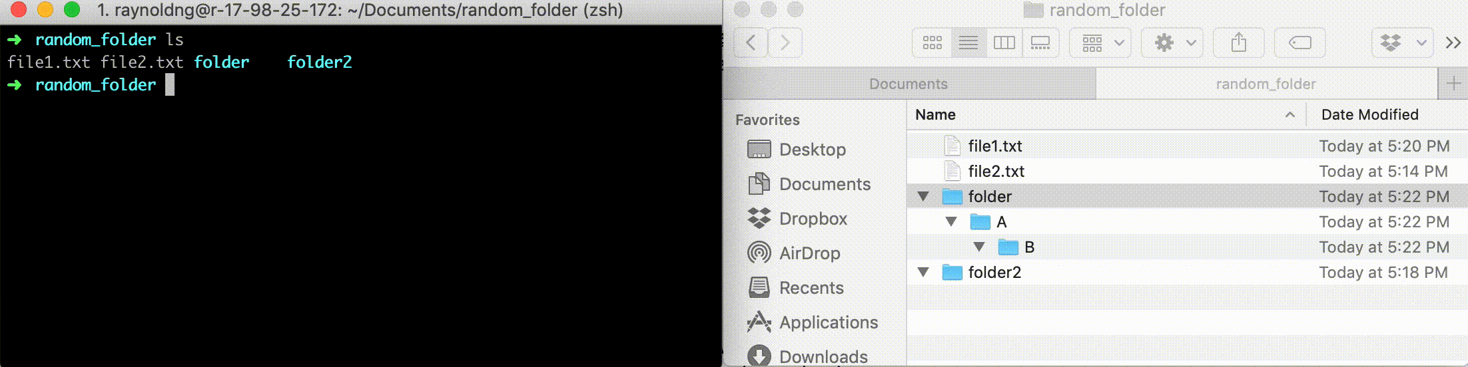
cd
Change directory. Change to certain directory name if provided

Slide 11
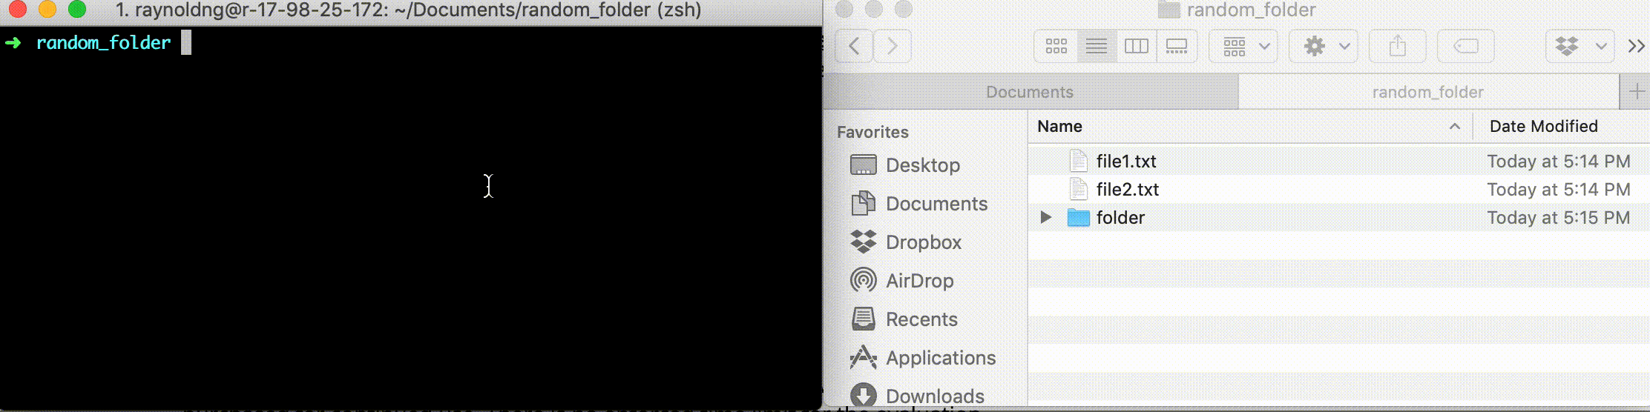
ls
Show directory contents, lists names of files

Slide 12
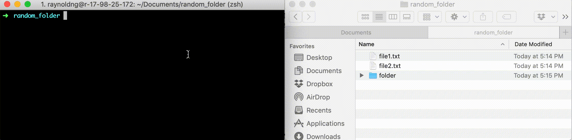
mkdir
Creates a directory of the specified name

Slide 13
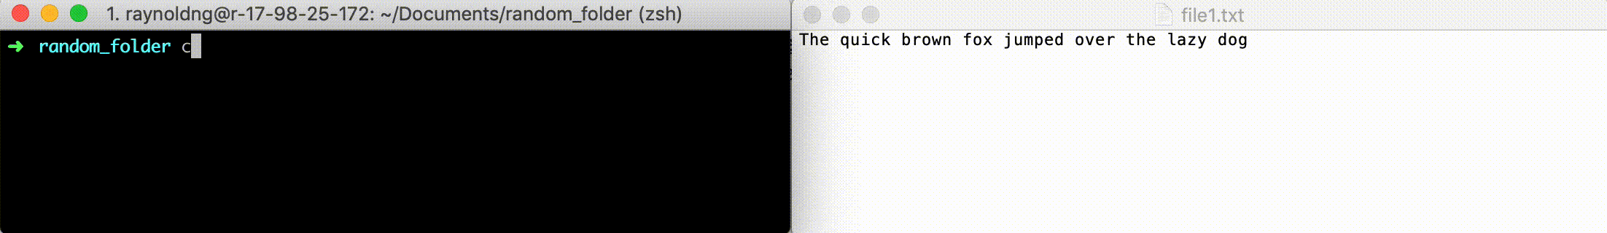
cat
Display contents of a file

Slide 14
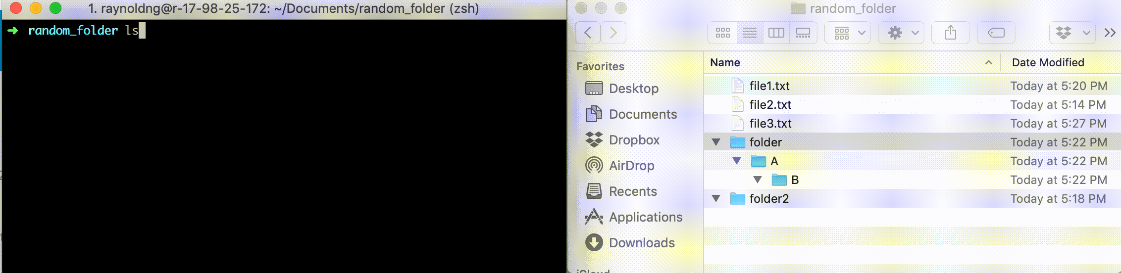
rm
Removes a specified file. PERMANENT

Slide 15
Ctrl-c
Cancels everything

Slide 16
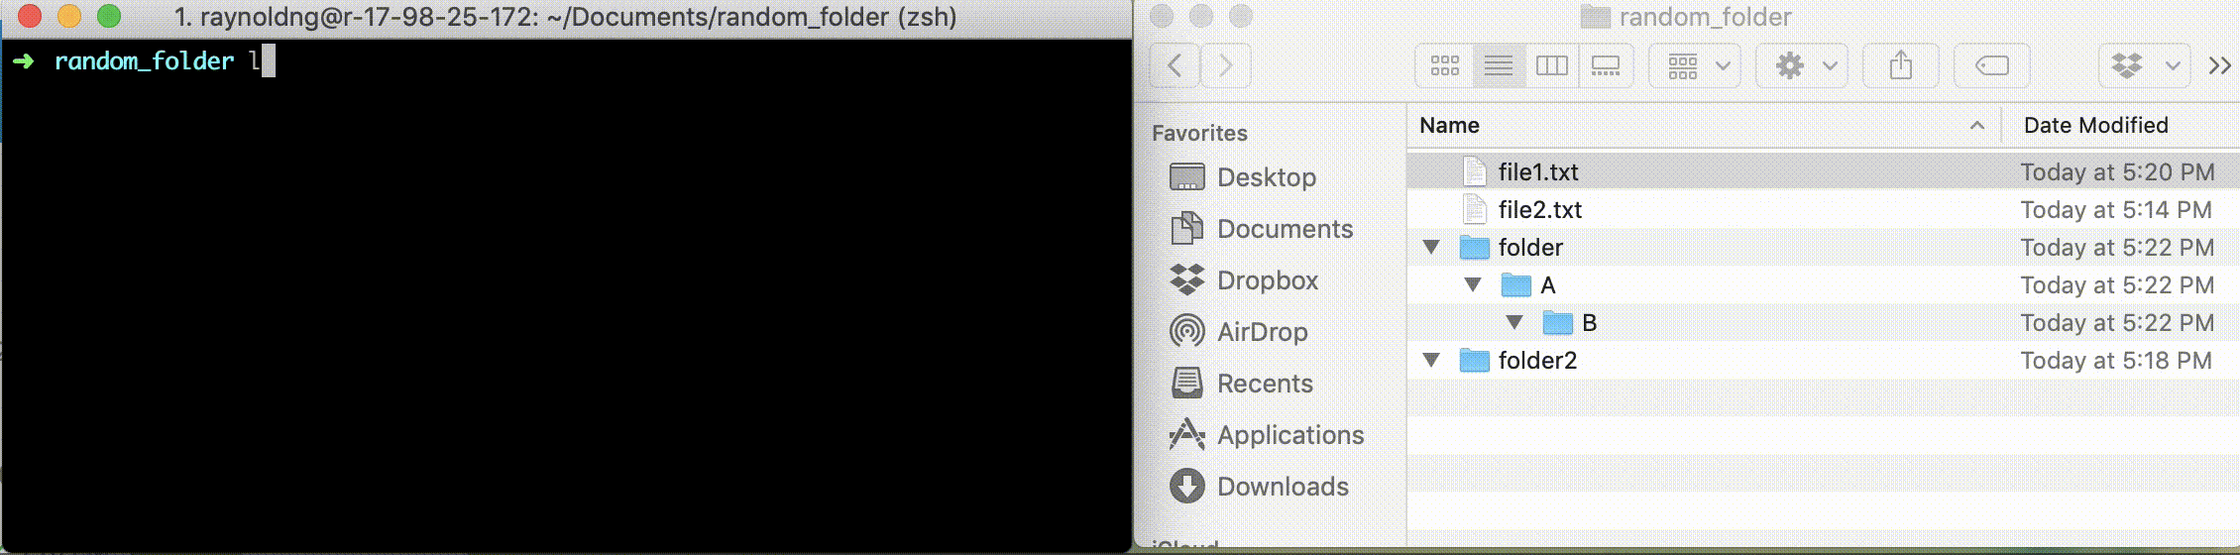
cp
Copy specific file to a new name file. Use -r flag to copy a directory

Slide 17
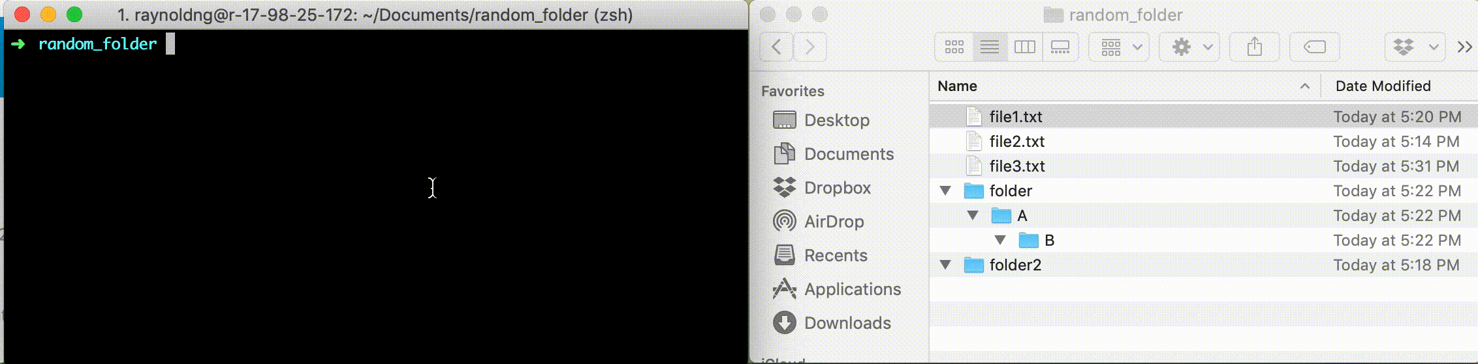
mv
Move/rename a file or directory

Slide 18
Tdlr;
cd <folder>: change directory
ls: show directory contents
mkdir <folder>: create a new folder
cat <file>: print contents of the file
rm <file>: remove file
rm -r <folder>: remove folder
cp <target> <destination>: copy target file to destination
mv <target> <destination>: move target file to destination
To learn more: https://www.unr.edu/research-computing/the-grid/using-the-grid/bash-commands

Slide 19
Using Git
Important git terminology are in magenta

Slide 20
Key Concept: Repositories
Often shortened to "repo"
Repository: Collection of all the files and history of these files
contains all commits
1 Repo <=> 1 Project
Can live on a local machine or on a remote server (e.g. Github)

Slide 21
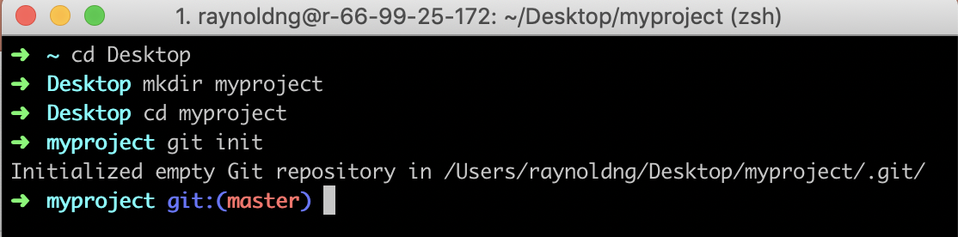
Step 1: Create local git repository

Slide 22
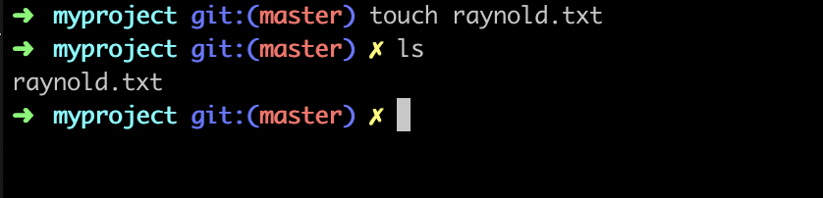
Step 2: Add a new file to the repo

Slide 23
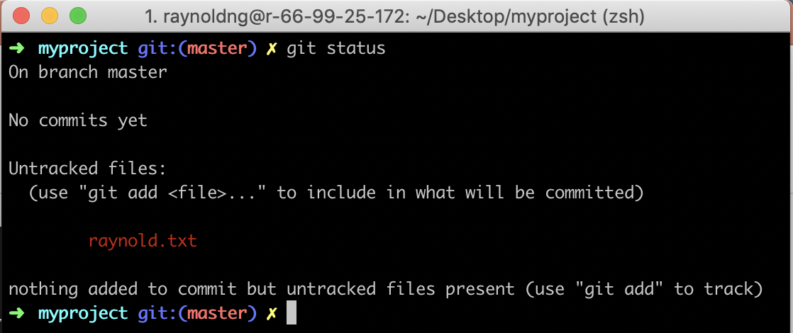
Check status of the repo

Slide 24
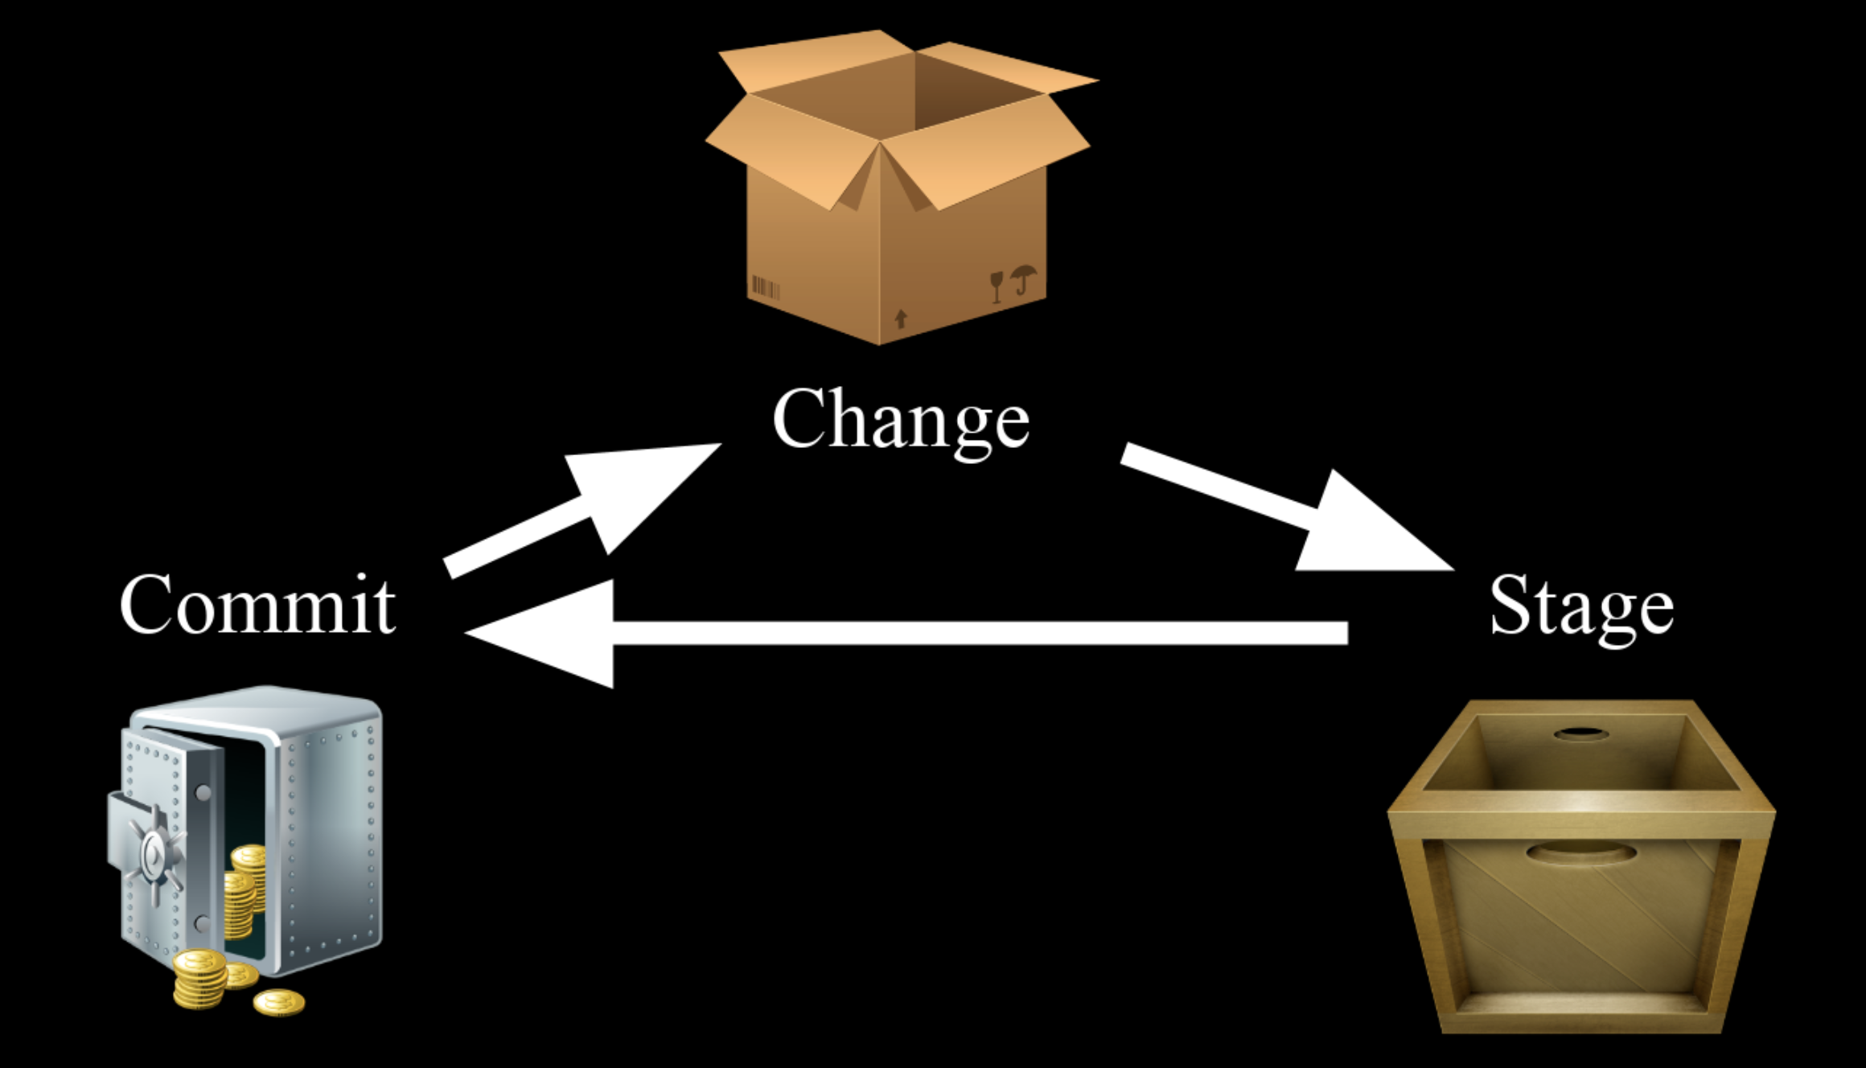
Commits and Staging Environment
Commit : record of files that you have changed since last commit
To add a file to a commit, you need to add it to the staging environment:
git add <filename>
Staging Environment: (or index) tracks changes that you want to commit
After using the git add command to add all the files you want, package them into a commit with the git commit command

Slide 25
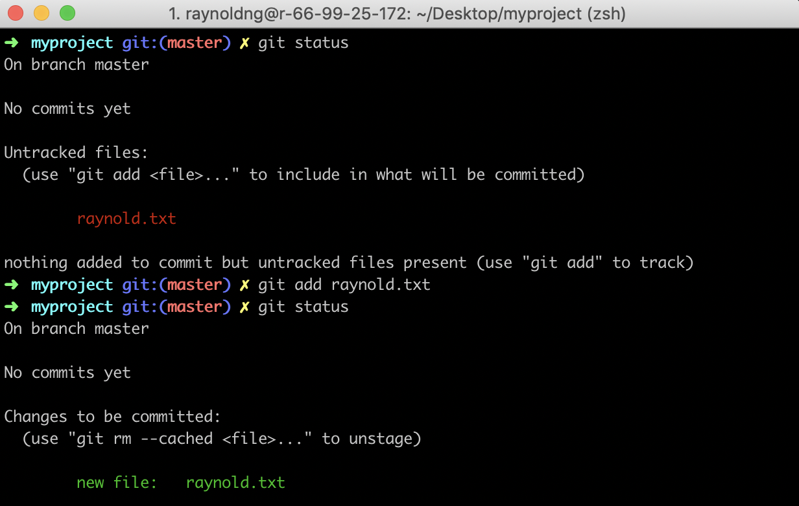
Step 3: Adding a file to staging environment /wooden box
git add <filename> : add change in working directory to the staging area
git add . : add all new or changed files

Slide 26
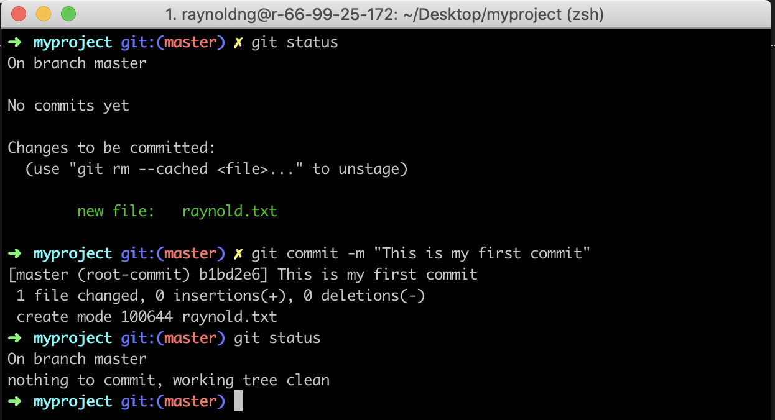
Step 4: Create a commit / moving to steel safe

Slide 27
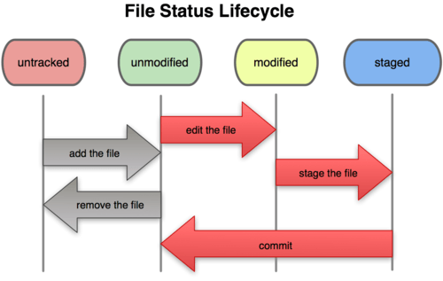
Recap

Slide 28
Check your log
99% of the time: git log
To see a very compressed log where each commit is one line:
git log --pretty=oneline
To see only the commits of a certain author:
git log --author=bob
Or maybe you want to see an ASCII art tree of all the branches, decorated with the names of tags and branches:
git log --graph --oneline --decorate --all
See only which files have changed:
git log --name-status
For more, see git log --help

Slide 29
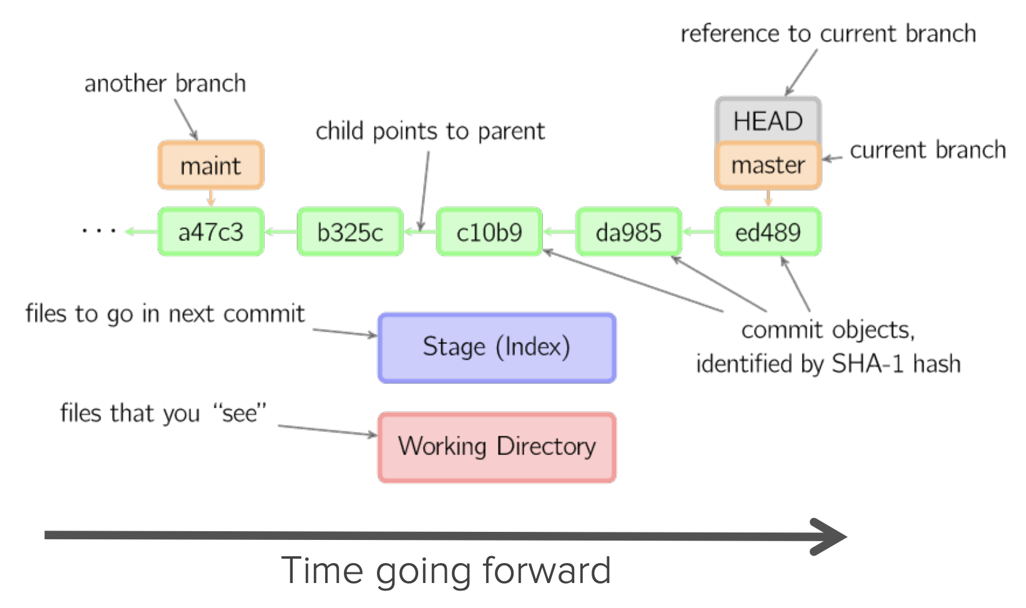



How does a typical project look like?

Slide 30
So many weird terms?
HEAD: a reference to the last commit in the currently checked-out branch
MASTER: (traditionally) the main branch in your project
Branch: pointer to some commit
Stage (cache): where you place files to commit to the git repo (wooden box)
Working Directory: current local directory that you are working on (cardboard box)

Slide 31
Quick Exercise
Add a few more lines to your_name.txt and commit the change
Create a new file, add some text and commit that change
The git add <filename> command adds the file to staging, how to undo that? (Hint: study the output of git status)

Slide 32
What is Github?

Slide 33
What is Github?
Largest web-based git repository hosting service. Hosts remote repositories
Allows for code collaboration with anyone online
Additional functionality on top of git
UI, documentation, issues, pull requests/review and more

Slide 34
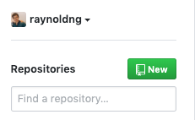
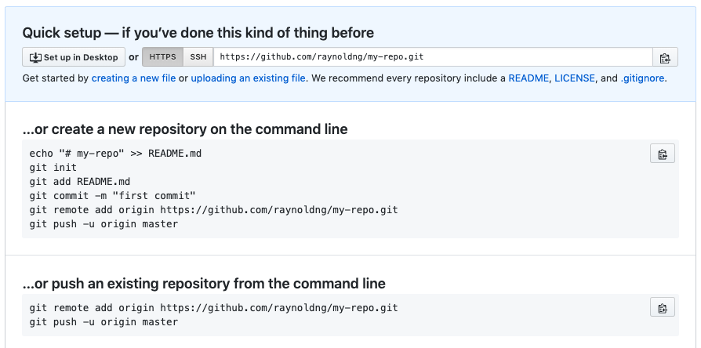
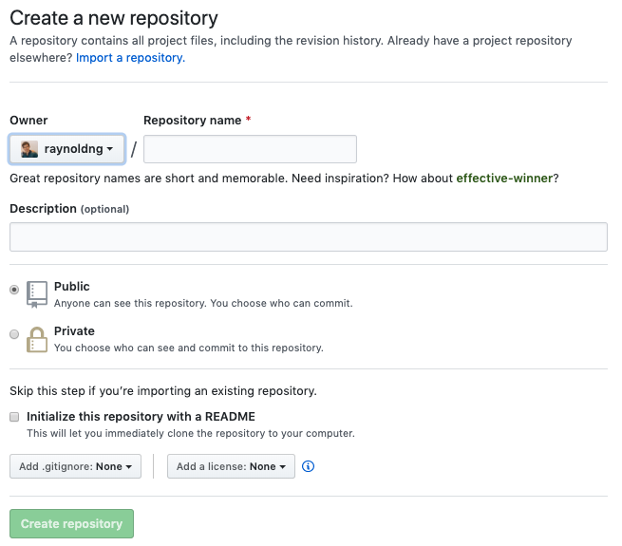
Step 5: Create a new repository on Github

Slide 35
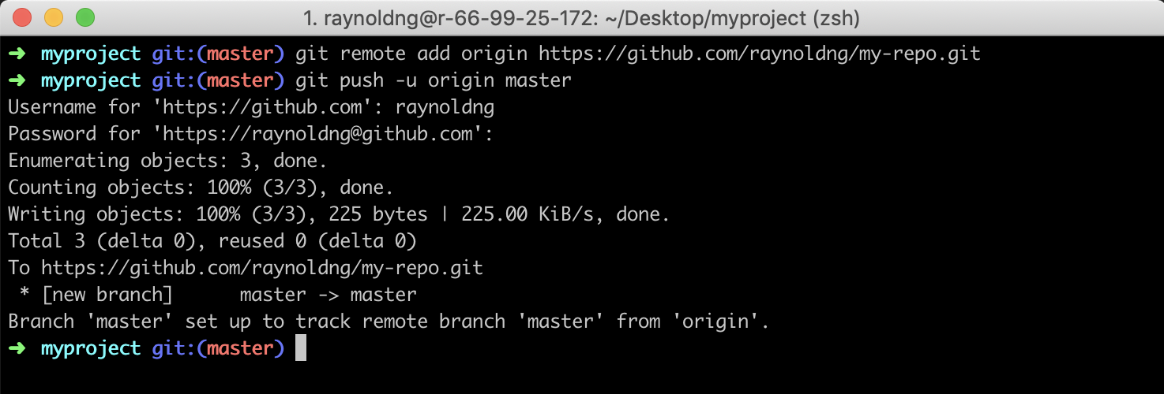
Step 6: Push master branch to Github
Specify remote upstream repo that will be synced; origin is the alias
-u: (one time only) sets up the association between master branch in local and master In origin

Slide 36
Refresh your github repo page!

Slide 37
Remotes
Remote: common repository that all team members use to exchange their changes
Usually stored on a code hosting service like Github or an internal server
git remote –v : list the remote connections that you have to other repositories
git remote add <name> <url> : create a new connection to a remote repo
git remote rm <name> : remove a remote
git remote rename <old-name> <new-name> : rename a remote

Slide 38

Pushing and Pulling
Pulling: downloading commits that don’t exist on your machine from a remote repository and merge the changes into your repository
Pushing: adding your local changes to the remote repository
Fetch: download changes but do not merge it in yet

Slide 39
Advanced Workflows
Branching and Merging
Pull Requests
Merge Conflicts
Undoing local changes
Time travelling

Slide 40
Key Concept: Branches
Killer feature of git
Branching: diverge from main line of development and continue to work without messing that main line
master: main branch in a project

Slide 41
Key Concept: Merging
Once you are done with your line of work, you merge it back into master

Slide 42
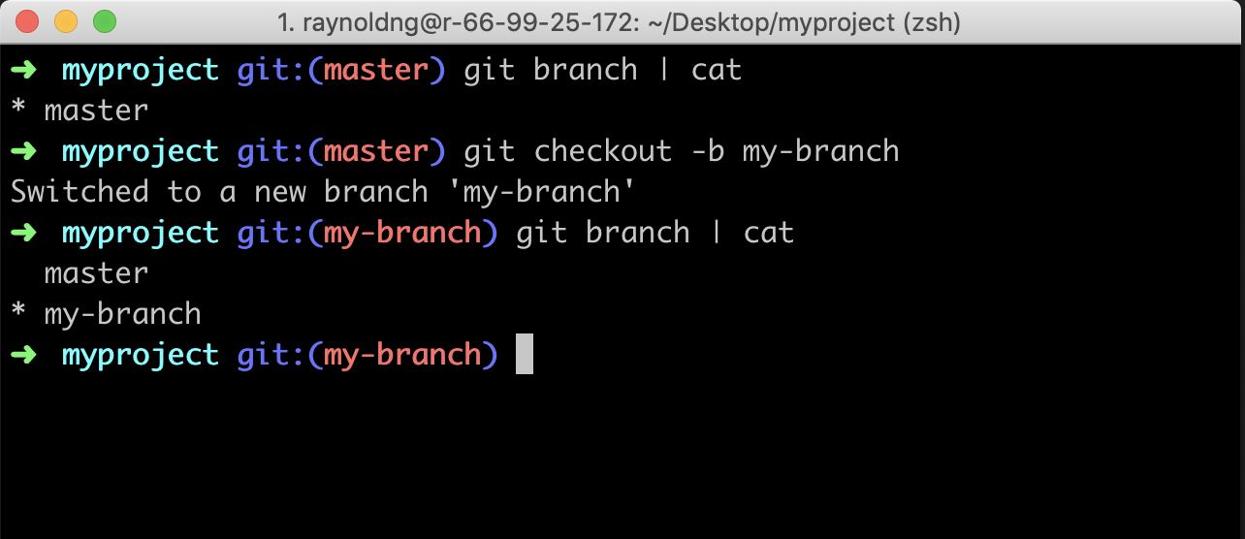
Step 7: Create a new branch
Create a new branch: git checkout -b <branch name>
-b: creates a new branch
git branch to list all branches

Slide 43
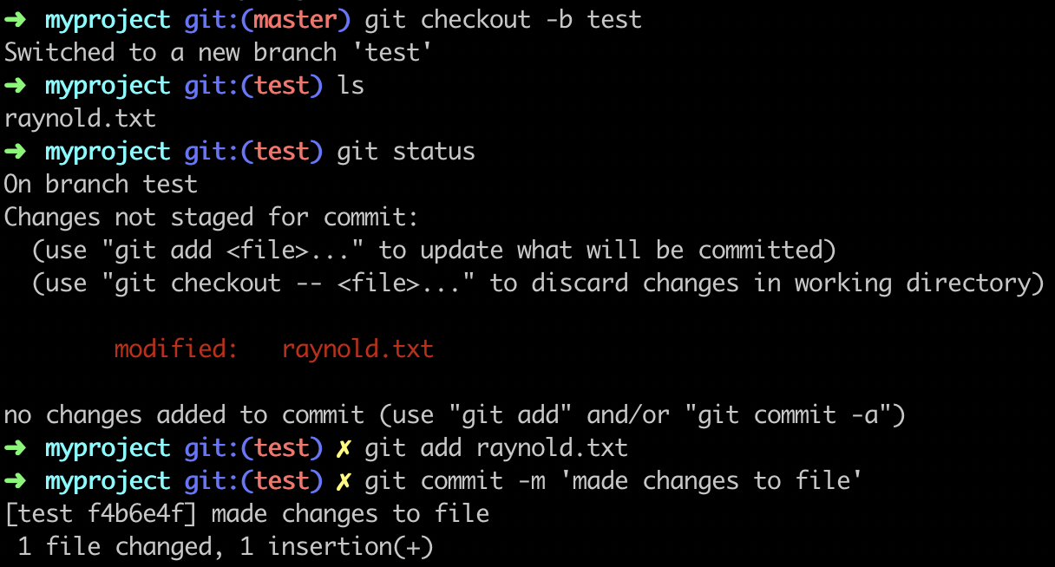
Step 8: Save changes to new branch

Slide 44
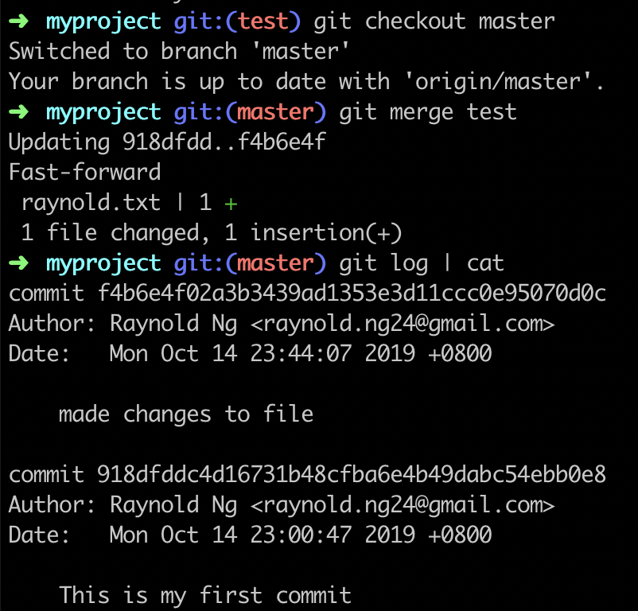
Step 9A: Merge changes into master
Need to checkout to branch that we are going to merge the branch into
If there is no changes on the master (current) since the branch out, we can do a fast forward merge

Slide 45
Creating a Pull Request

Slide 46
About Pull Requests
To tell others about changes that you’ve pushed to a branch in a repo on Github
After you open a PR, you can discuss and review the potential changes with collaborators and add follow-up comments before are merged into the base branch

Slide 47
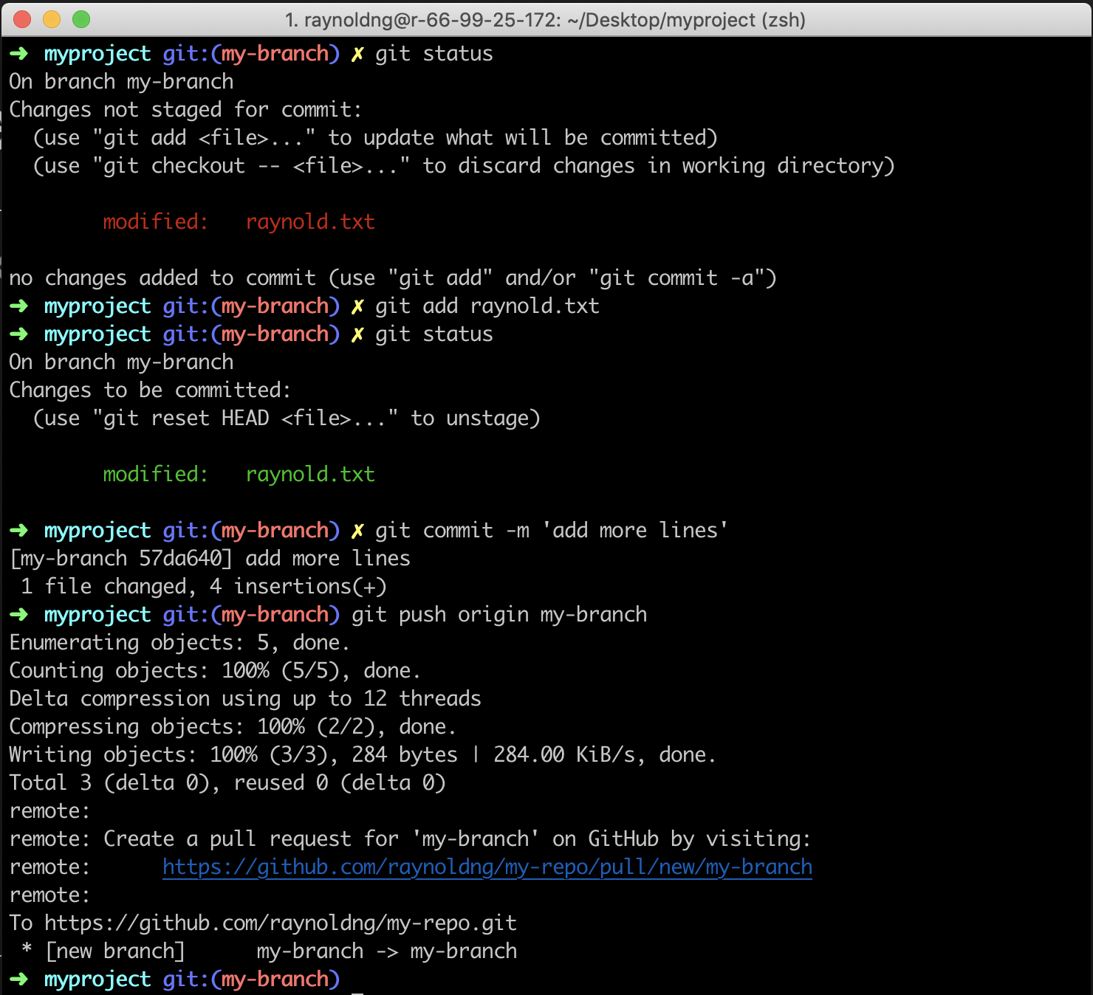
Step 9B: Push changes to remote branch
To push changes to a new branch on github:
git push origin <branch name>
origin: shorthand for the remote repository URL

Slide 48
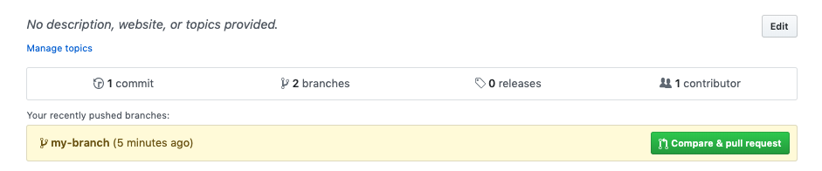
See your new branch on Github

Slide 49
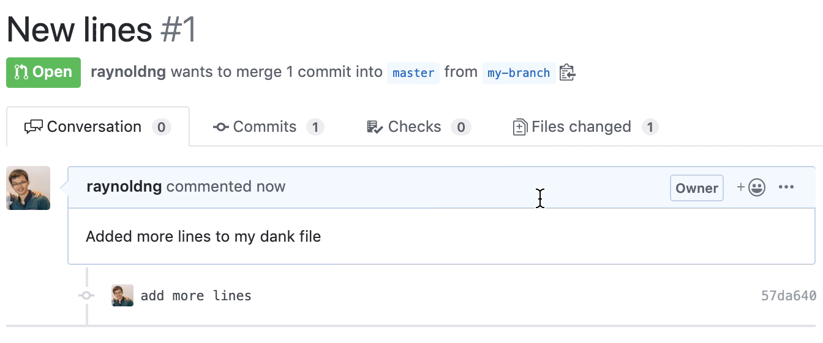
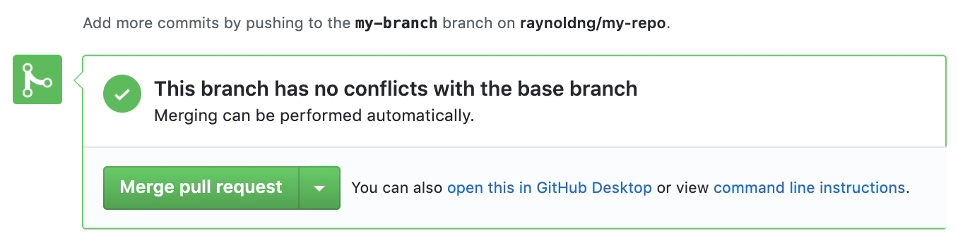
Step10: Create a Pull Request

Slide 50
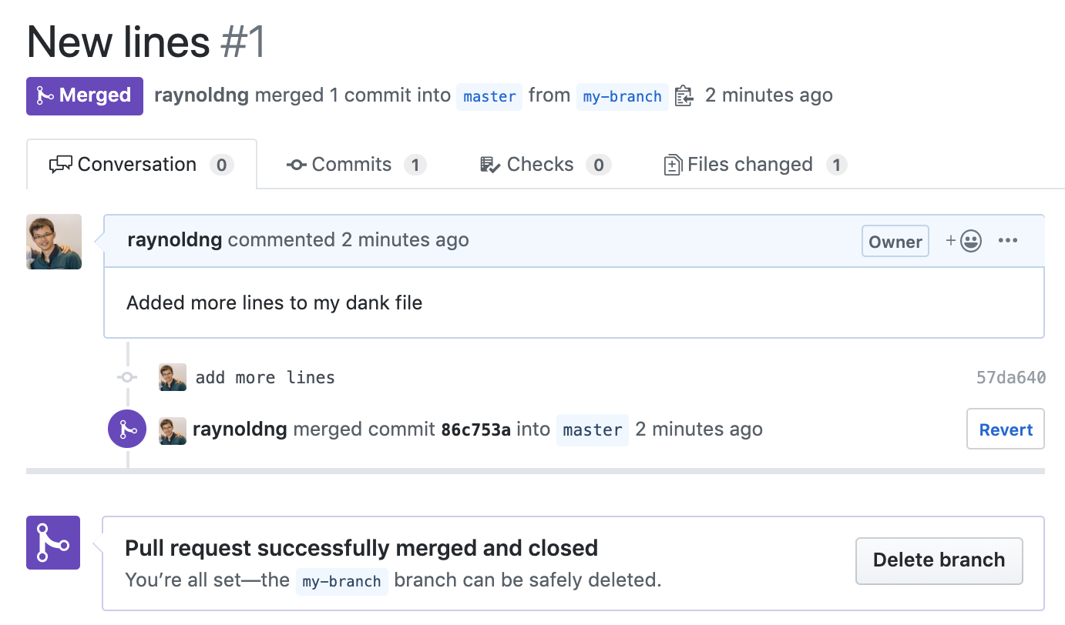
Goal:
Good idea to delete merged branches

Slide 51
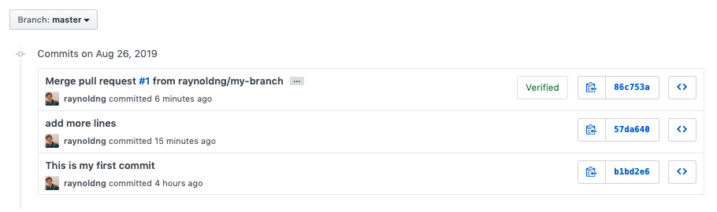
Updated master branch
Merging branches will always create a merge commit

Slide 52
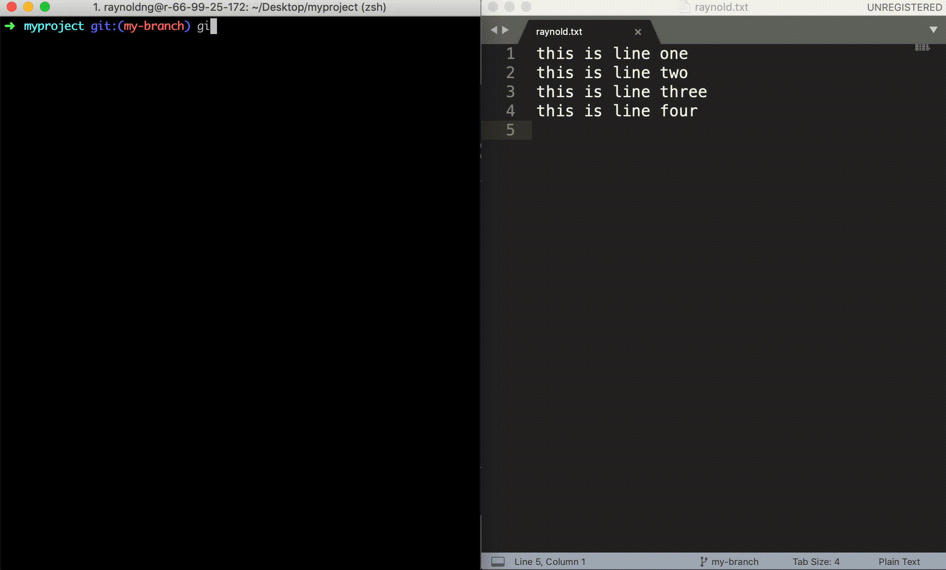
Step 11: Get changes back on your computer

Slide 53

Checkout
Act of switching between different versions of the target entity
git checkout <branch name/commit>
git checkout -b <new branch name> : create a new branch
git checkout <branch/commit> <filename> : restore previous version of file

Slide 54
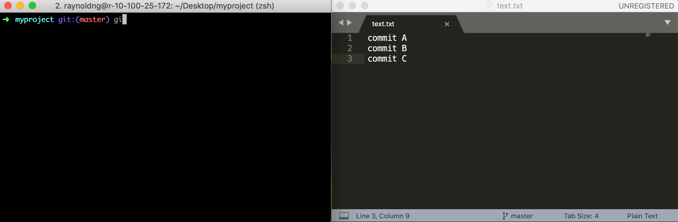
Checkout previous version of file

Slide 55
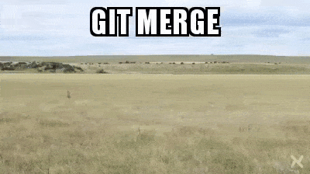
Merge Conflicts

Slide 56
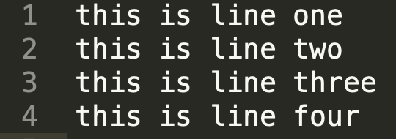
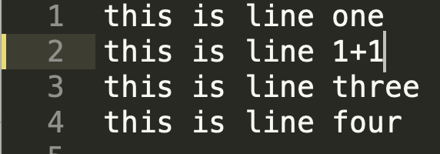
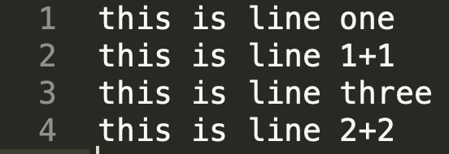
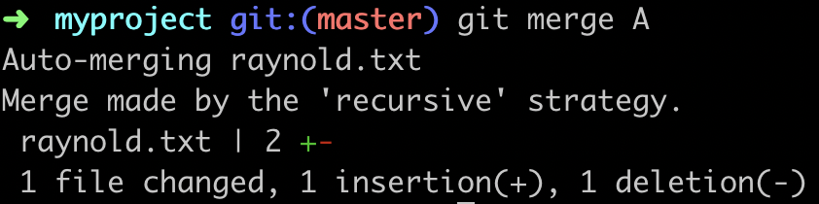
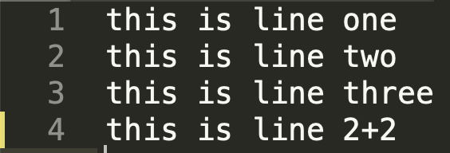
Conflict Free Merge
HEAD
A

Slide 57
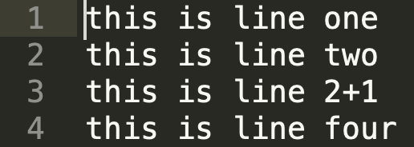
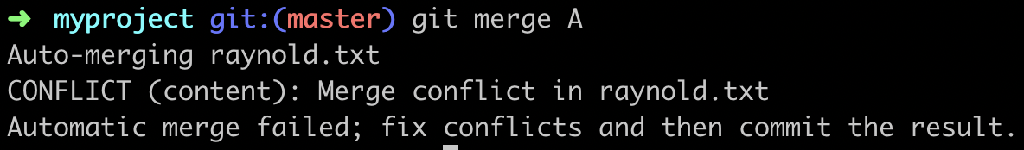

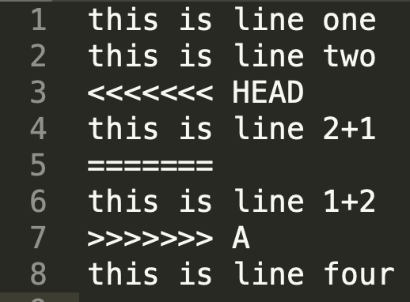
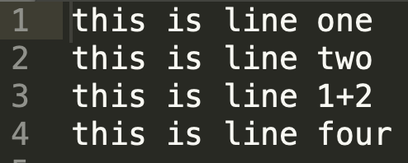
Merge Conflict
HEAD
A

Slide 58
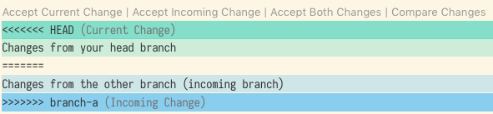
Resolving the Conflict

Slide 59
Undo local changes
git reset --hard/mixed/soft
Hard
Mixed
Soft
HEAD
Index
Working Dir
Scope of changes (e.g. Soft: index and working dir unchanged)

Slide 60
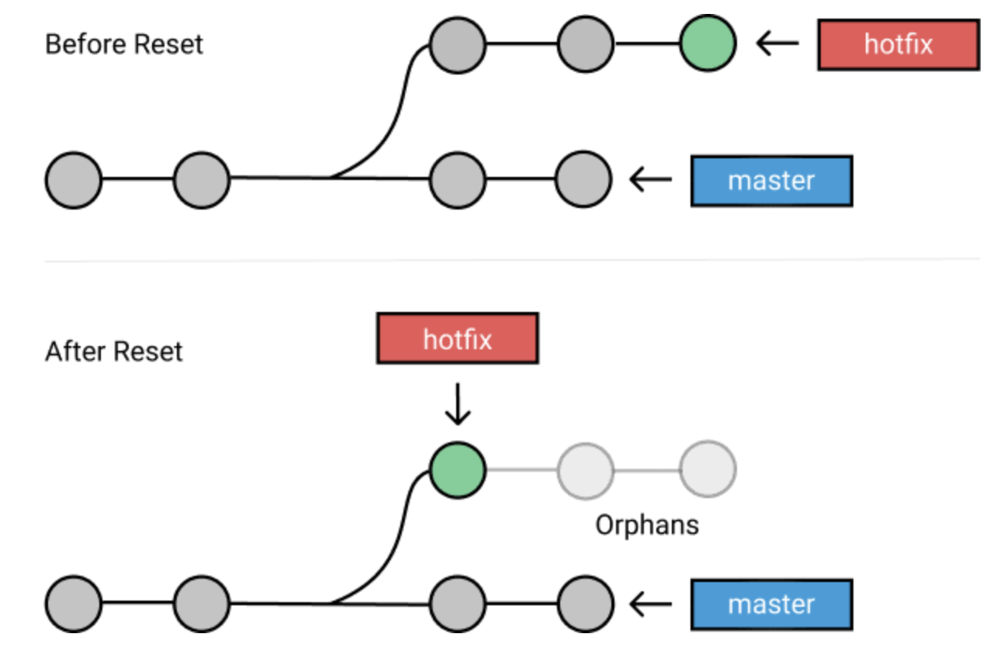
Soft Reset (default)
Rewinds repo to specified commit
Left out commits are orphaned and REMOVED next time git performs garbage collection
git reset HEAD~1 : go back one commit
git reset HEAD~2 : go back two commits

Slide 61
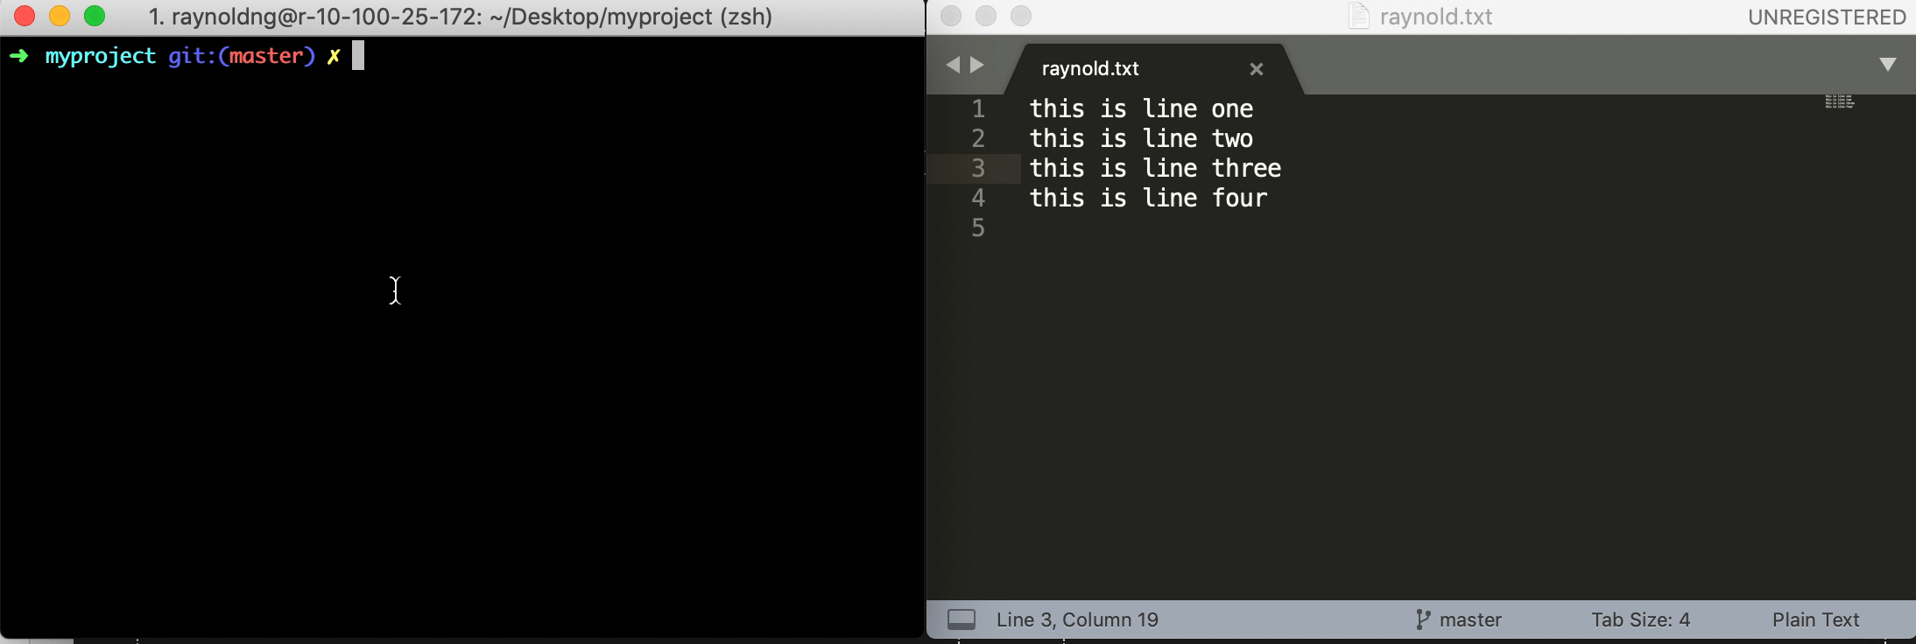
Soft Reset (default)

Slide 62

Git hard reset (oof)
When things go so wrong and you don’t even want to salvage it
Removes ALL TRACES of your changes

Slide 63
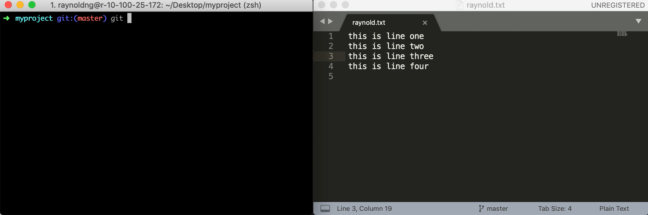
Hard Reset

Slide 64
Final Activity: Making and merging PR request

Slide 65

Forking Repos
When you want to contribute to a github repo or use it as your starting point
Fork repo
Clone the forked repo
Make and push changes
Make Pull Request

Slide 66


Cloning the Repo

Slide 68
Your first approved PR
Go to https://github.com/raynoldng/my-repo
⭐ it
Fork it (you will be redirected toyour new repo page)
Clone into your local machine
Create a new branch <your_name_4D>
Add a new file <your_name>.txt and add some text in it
Commit your changes and push it
Make the PR request
Profit

Slide 69


Git n00b Certified!

Slide 70
What we did not cover
Rebasing (rewriting history/cracking the steel safe)
Git hooks
Stashing (saving it for later)
Git revert (commits to undo commits)
Cherry picking (picking certain commits)

Slide 71
Quality of Life Hacks
Aka name dropping

Slide 72
Git GUI Clients: Normie Tools

Slide 73
More Git Clients
Tig: text-mode interface for Git
Git History Diff

Slide 74
Thank you!
Feedback:
http://bit.ly/hs-2019-git-feedback

